Slide 1
The National Care Experience Programme
Last updated: 29 July 2022.
For the latest version of this slide deck, please visit:
https://yourexperience.ie/about/about-the-programme/#academic_slide_deck
For more information, please contact: info@yourexperience.ie.

Slide 2
Introduction
What is the purpose of this slide deck?
This slide deck has been developed by the National Care Experience Programme (NCEP) to provide a teaching resource on national care experience surveys.
Who is this slide deck for?
This slide deck will be useful for those teaching health and social care students and those providing training for health and social care staff.

Slide 3
Introduction
How can this slide deck be used?
The slide deck has been designed to be used in a flexible way. Content has been divided into different sections and these can be delivered together or separately.
These slides may be adapted for teaching and training purposes.
We ask that you acknowledge NCEP as the source of these materials.

Slide 4
About the National Care Experience Programme
The National Care Experience Programme seeks to improve the quality of health and social care services in Ireland by asking people about their experiences of care and acting on their feedback. The National Care Experience Programme is a joint initiative by the Health Information and Quality Authority (HIQA), the Health Service Executive (HSE) and the Department of Health.
The National Care Experience Programme has a suite of surveys that capture the experiences of people using our services. The Programme implements the annual National Inpatient Experience Survey, the National Maternity Experience Survey and the National Nursing Home Experience Survey, and is currently developing the National Maternity Bereavement Experience Survey and the National End of Life Survey.

Slide 5
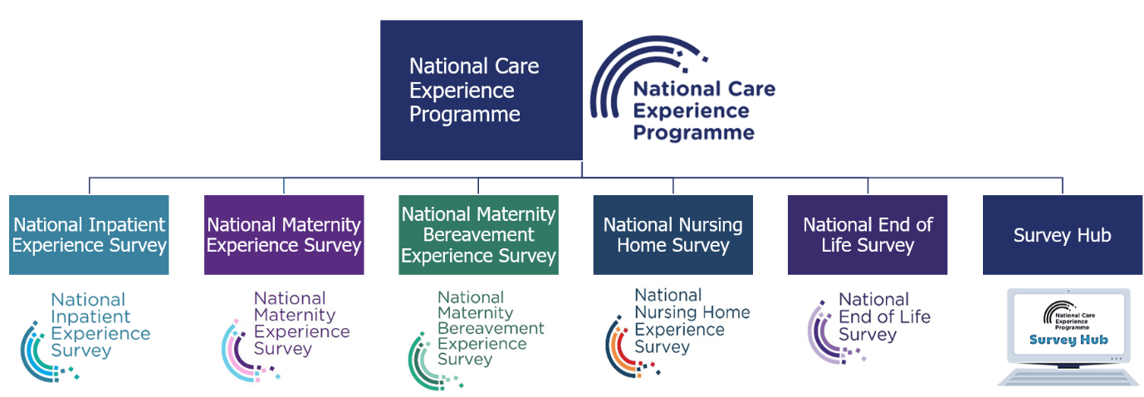
About the National Care Experience Programme
The surveys aim to learn from people’s feedback about the care received in health and social care services to find out what is working well, and what needs to be improved.
A National Care Experience Programme Survey Hub is available to provide support, guidance, information and resources to assist providers to develop, conduct and analyse their own surveys, and act upon the findings.

Slide 6
Outline of the slide deck
About the Health Information and Quality Authority (HIQA)
Healthcare quality and safety
National Care Experience Programme
Impact
Useful resources

Slide 7
Section 1. About the Health Information and Quality Authority (HIQA)

Slide 8
The Health Information and Quality Authority
Promoting and protecting human rights
We will work to promote human rights as well as identifying, challenging and reporting on breaches of rights in health and social care services
Putting people first
We will put the voice and needs of people at the centre of our work and strive to identify, challenge and report on breaches to agreed standards
Being fair, objective and equitable
We will be fair, objective and consistent in our dealing with people and organisations
Being open and accountable
We will communicate the nature and outcomes of our work in an open and transparent way, accepting full responsibility for our actions
Striving for excellence
We will continually innovate and improve the quality of our work through robust research, striving for methodical rigour and using the best available resources and evidence
Promoting quality
We will promote quality within our own organisation and across all health and social care services
Working collaboratively
We will engage and work collaboratively with all our stakeholders
HIQA is an independent statutory authority, established in 2007, to improve the safety and quality of health and social care services for the public.

Slide 9
HIQA’s functions
Setting standards for health and social care services Developing person-centred standards and guidance, based on evidence and international best practice, for health and social care services in Ireland.
Regulating social care services The Chief Inspector within HIQA is responsible for registering and inspecting residential services for older people and people with a disability, and children’s special care units.
Regulating health services Regulating medical exposure to ionising radiation.
Monitoring services Monitoring the safety and quality of health services and children’s social services, and investigating as necessary serious concerns about the health and welfare of people who use these services.

Slide 10
HIQA’s functions
Health Technology Assessment Evaluating the clinical and cost-effectiveness of health programmes, policies, medicines, medical equipment, diagnostic and surgical techniques, health promotion and protection activities, and providing advice to enable the best use of resources and the best outcomes for people who use our health service.
Health Information Advising on the efficient and secure collection and sharing of health information, setting standards, evaluating information resources and publishing information on the delivery and performance of Ireland’s health and social care services.
National Care Experience Survey Carrying out national service-user experience surveys across a range of health services, in conjunction with the Department of Health and the HSE.

Slide 11
Overview of Health Information and Standards
The Health Information and Standards (HIS) Directorate aims to support a consistent and standardised approach to health and social care service provision and information in Ireland and bring about effective and sustainable improvements to Irish health and social care services. The HIS Directorate has three core functions:
Development of National Health and Social Care Standards and Guidance The Standards Team develops national standards and implements supports for health and social care services in Ireland.
Informing and driving health information quality and eHealth The Technical Standards Team and the Health Information Quality Team develop recommendations, national standards and guidance for the Irish eHealth and health information landscape, and assess against national standards.
Surveying the experiences of people who use health and social care services The National Care Experience Programme Team conducts three surveys currently, and is developing a further two surveys.

Slide 12
Section 2. Introduction to healthcare quality and safety

Slide 13
Healthcare quality and safety
Healthcare quality is a multi-dimensional concept
Institute of Medicine (2001):
Safe
Effective
Patient-centred
Timely
Efficient
Equitable
Healthcare quality
Safe
Effective
Patient-centred
Timely
Efficient
Equitable

Slide 14
Healthcare quality and safety
National Standards for Safer Better Healthcare (HIQA, 2012)
Person-centred
Effective
Safe
Better health and wellbeing
The purpose of the NCEP is to deliver demonstrable improvement in patient experience.
Definition of quality within the Irish healthcare system (HSE, 2016)

Slide 15
What is patient experience?
“The sum of all interactions, shaped by an organisation’s culture, that influence patient perceptions, across the continuum of care.”
The Beryl Institute (2016)
Putting care users and patients at the centre of their care
Reflecting on the experience of the care user or patient, as reported by the user, and learning from their feedback to improve the planning and delivery of healthcare
Central to the delivery of quality, person-centred healthcare
An important predictor of patient outcomes.

Slide 16
What is patient experience?
(click video to play)
https://youtu.be/cXGqCoxD8l4

Slide 17
Why measure the experiences of those who use health and social care services?
Research has consistently demonstrated that positive experience is associated with
better health outcomes
a reduced risk of medical malpractice
increased health and social care staff satisfaction.
Sláintecare, the Government’s 10-year plan for health service reform advocates the use of standardised national patient surveys to inform improvements, and where appropriate, shape policy.

Slide 18
Who benefits?
Health and social care service users:
Encourages them to be involved in their own care and improves the quality of their care.
Service providers: Helps to identify areas for improvement in care.
Regulators: Informs quality and safety of care.
Policy-makers: Informs national policy and planning.

Slide 19
Section 3. The National Care Experience Programme

Slide 20
Mission and values
Hearing, understanding and responding to the experiences of people using Ireland’s health and social care services to drive and embed sustainable improvement.
Human Rights Based Approach
Putting people first
Being fair and objective
Being open and accountable
Striving for excellence
Working together
National Care Experience Programme Strategy 2022-2024, available at: https://yourexperience.ie/wp-content/uploads/2022/01/NCEP_Strategy_2022_2024-1.pdf

Slide 21
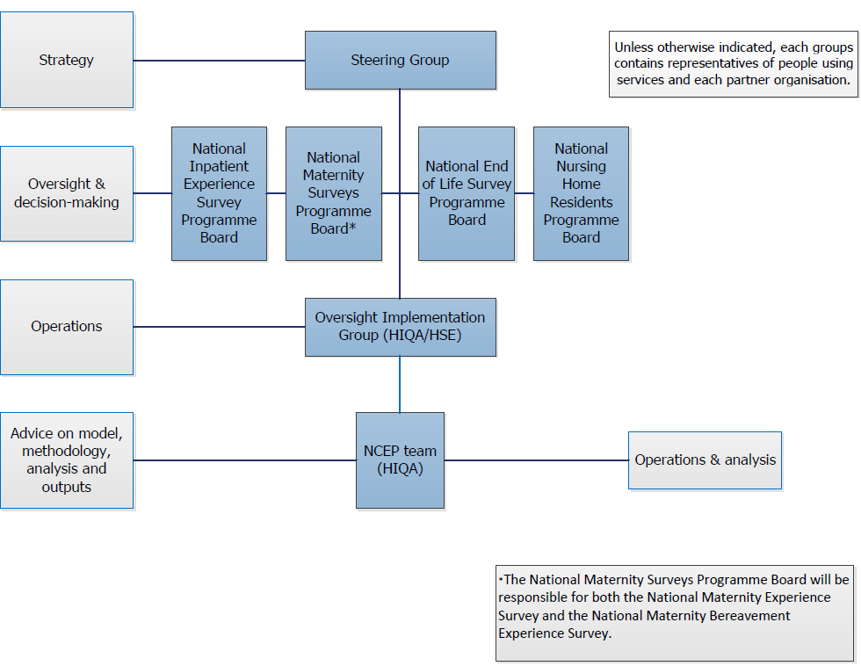
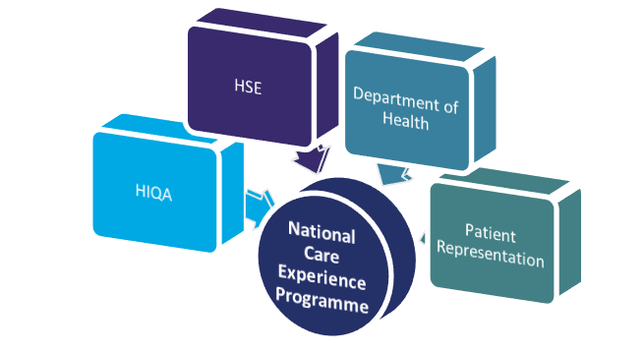
Partnership and governance

Slide 22
Objectives
1. Elevate people’s voices for service improvement
2. Responsive to national need
3. Be innovative and rigorous
4. Build capability
Objectives
Notes:
PESTLE – Political, economic, social, technological, legal, environmental

Slide 23
Survey development process
International review
Focus groups
Gap analysis
Delphi study
Cognitive testing
Assembly of questions
Development of National Care Experience Programme surveys follows a structured approach, in line with the NCEP Quality Assurance Framework (NCEP 2021).
of care experience surveys
with key stakeholders to identify themes to be included
of national policies, guidance and standards
bank of potential survey items
to prioritise items for inclusion
to check clarity and understanding

Slide 24
Communication
Communicating the purpose and importance of the National Care Experience Programme surveys is intrinsic to its success.
Communication and stakeholder engagement
Communication & stakeholder engagement plan
Survey support documentation
Promotional material
Social media
Website
Podcasts
Development of e-learning support materials

Slide 25
National Care Experience Programme Surveys
National Inpatient Experience Survey
National Maternity Experience Survey
National Nursing Home Experience Survey
National Maternity Bereavement Experience Survey
National End of Life Survey
National Care Experience Programme
National Maternity Experience Survey
National Maternity Bereavement Experience Survey
National Inpatient Experience Survey
National End of Life Survey
National Nursing Home Survey

Slide 26
National Inpatient Experience Survey

Slide 27
National Inpatient Experience Survey
Ireland’s first acute inpatient experience survey, carried out in 2017.
The survey asks patients about their experiences in hospital to identify areas of good experience, and areas needing improvement.
The findings help to inform the development, planning, design and delivery of improved patient-centred care in public hospitals.

Slide 28
National Inpatient Experience Survey 2021
(click video to play)
https://youtu.be/RPN7FXSjVZw

Slide 29
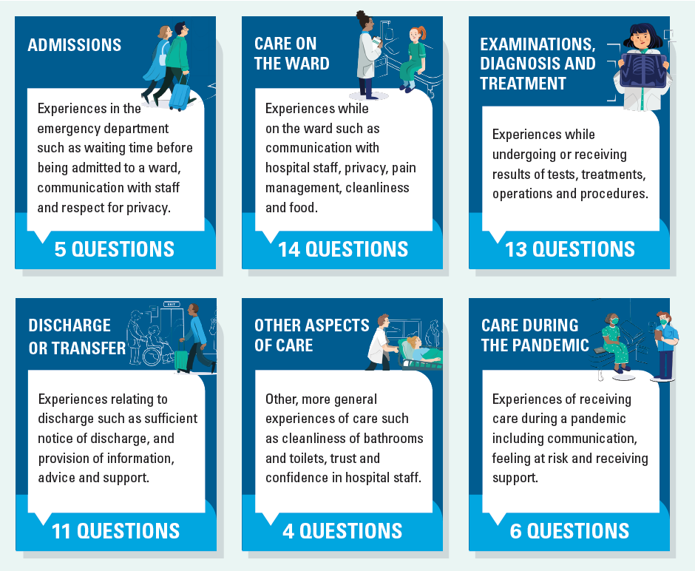
National Inpatient Experience Survey
Patients’ experiences of:
admission to hospital
care on the ward
examination, diagnosis and treatment
discharge or transfer
overall experience
care during the pandemic
3 free-text questions where patients are asked what was good, what could be improved, and for other comments.

Slide 30
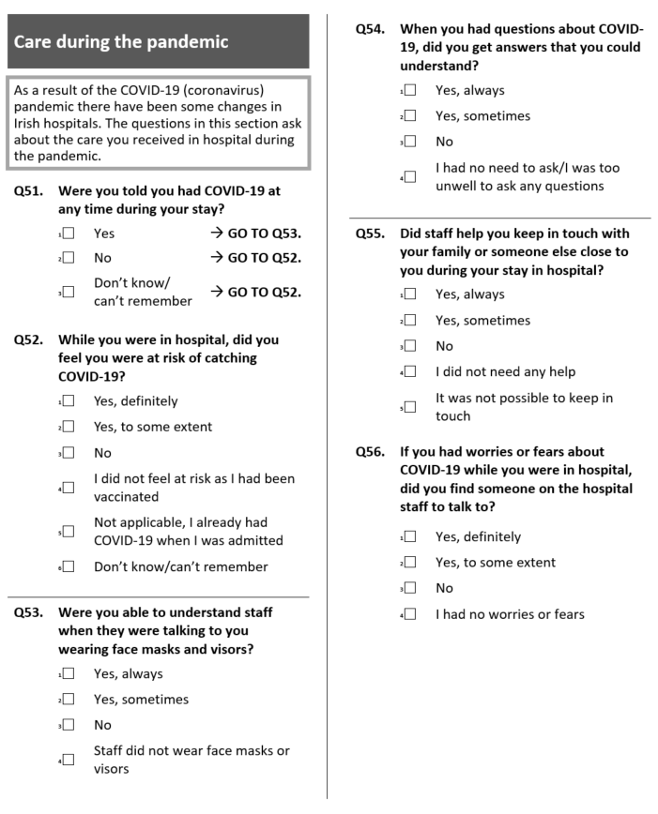
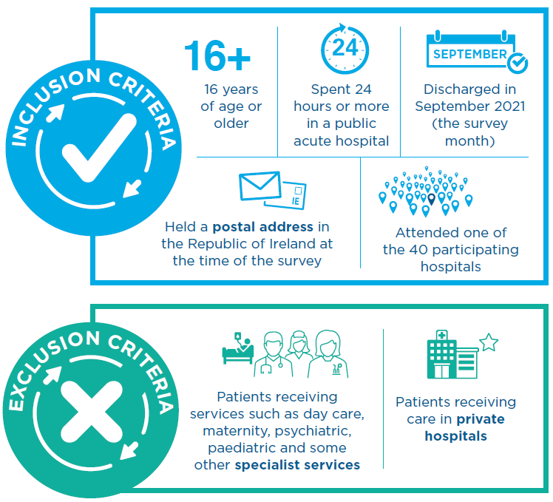
National Inpatient Experience Survey 2021
No survey in 2020 due to COVID-19.
The 2021 survey was adapted for use during the COVID-19 pandemic.

Slide 31
Who took part in the National Inpatient Experience Survey 2021?
Reason for admission
25,346 people invited
10,743 took part (42%)
Characteristics of participants
Age category | N | %
16 to 35 years | 778 | 7.2
36 to 50 years | 1,295 | 12.1
51 to 65 years | 2,599 | 24.2
66 to 80 years | 4,228 | 39.4
81 years or older | 1,843 | 17.2
Sex
Male | 5,338 | 49.7
Female | 5,405 | 50.3
Admission route
Emergency | 8,435 | 78.5
Non-emergency | 2,308 | 21.5

Slide 32
Overall experience (2021)
Nationally, the average overall rating of care was 8.1 out of 10
83% of people said that they had a good to very good experience in hospital (overall rating between 7 and 10).

Slide 33
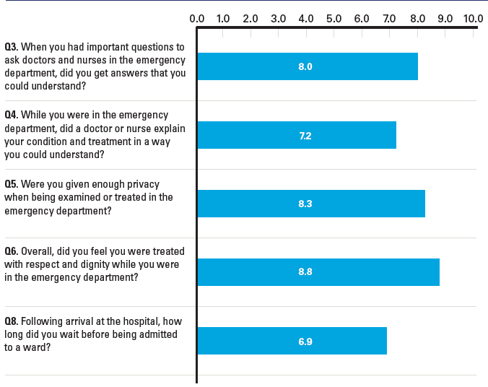
Admissions
81% of people said that they were always treated with respect and dignity in the emergency department
71% said they waited longer than the HSE target of six hours before being admitted to a ward.
Emergency department waiting times

Slide 34
Comments from patients on admissions
“It was ridiculous waiting time, nine hours and all the people lying on trolleys is shocking.”
“From moment I arrived in A/E to emergency room, the care and attention was excellent. Most nurses were very caring and kind.”
“A&E was very poor in general with no privacy whatsoever. A person definitely has no dignity, was able to hear everyone’s business.”
“Facilities in A&E very good. Care & attention & speed in dealing with my problem, 1st class.”

Slide 35
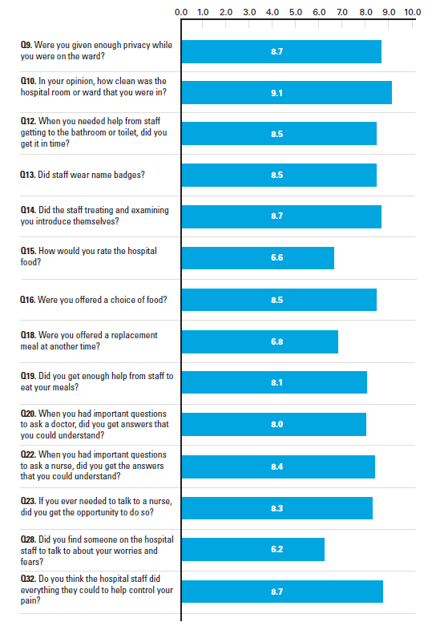
Care on the ward
76% of people said that the hospital room or ward that they were in was very clean.
22% said that they did not find a member of staff to talk to about their worries and fears.

Slide 36
Comments from patients on care on the ward
“The care and attention that I received was top class. Every worker did their jobs with great pride and professionalism. They were kind, caring compassionate and friendly. I felt very privileged to be in the hands of a very skilled team of healthcare workers. The team of porters were excellent and had great patience. The cleaning staff were superb and were constantly cleaning.”
“Some nursing staff were often too busy to answer any of my seldom asked questions. Many of them never made eye contact whilst doing my drug list, this was very upsetting as they were wearing masks also.”
“There should be an alternative meal option for patients who miss their three meals throughout the day while fasting. I don't think tea and toast is a meal.”
“The nurses in the day ward were very kind and helpful. And the staff in general were great. The doctor… came to explain my procedure and my options was fantastic.”

Slide 37
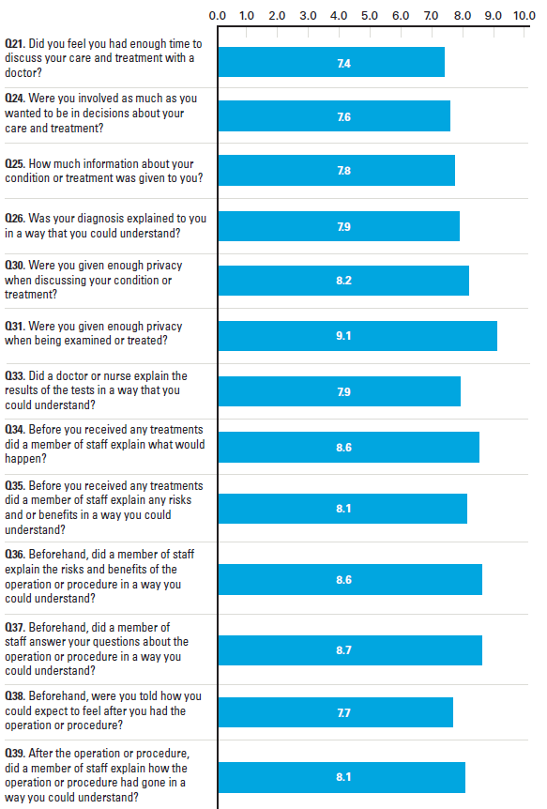
Examinations, diagnosis and treatment
86% of people said that they were always given enough privacy when being examined or treated on the ward.
10% said that they did not have enough time to discuss their care and treatment with a doctor.

Slide 38
Comments from patients on examinations, diagnosis and treatment
“Doctors never explained the side effects of the treatment I was getting and those side effects were causing me to vomit and no one told me why. This went on for several days and the day after I was taken off this treatment, I was eating and went home.”
“The doctors on the team were brilliant. Before the procedure they sat down with me and explained everything in great detail, the good and the bad. This continued after the procedure. They gave me as much time as I needed.”
“Privacy, everyone on our ward knew each other’s condition as the surgeons would explain behind the closed curtain but we could hear it all.”
“’I was very impressed with a fast diagnosis and immediately moved for operation. I felt very looked after for my whole stay.”

Slide 39
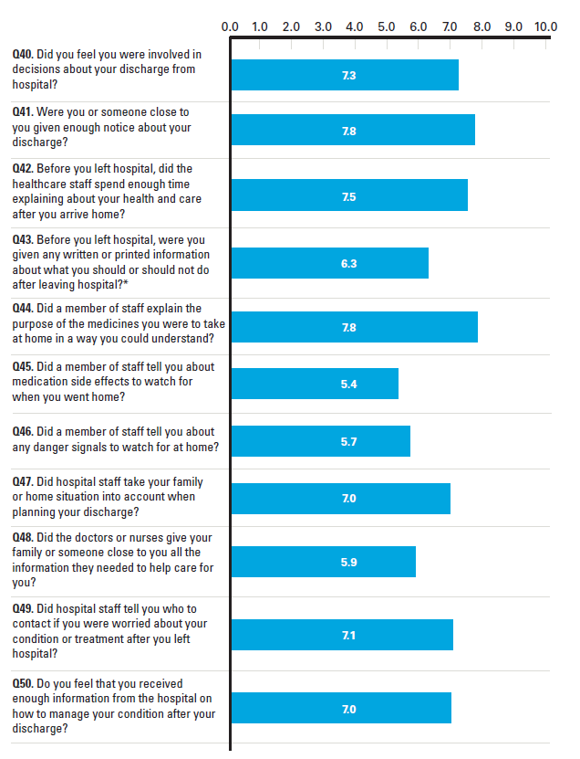
Discharge or transfer
69% of people said that the purpose of medications they were to take at home was fully explained to them
36% of people who received medication said that they were not informed about the side effects to watch for when they went home.

Slide 40
Comments from patients on discharge or transfer
“On discharge, was very late. I was rushed out of the unit by 2 carers who packed my belongings into plastic bags and was left in family room for 2 hours to wait for family member to organise transport to collect me and take home. Felt carelessly done as I had had mini stroke, felt fragile.”
“I was discharged quicker than I expected which was good.”
“The care was very good. Very good follow up after I came home.”
“The discharge. No information provided to family about the procedure or follow up care.”

Slide 41
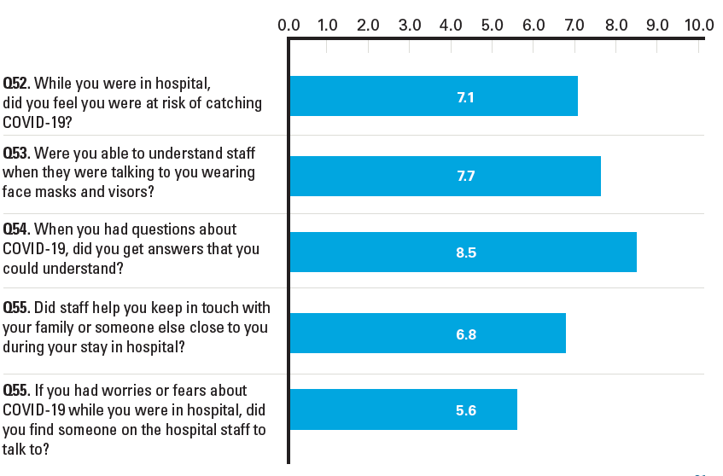
Care during the pandemic
68% of people said that they did not feel they were at risk of catching COVID-19 while in hospital.
814 people (12%) said that they definitely felt at risk of catching COVID-19.
42% of people said that they always got answers they could understand when they had questions about COVID-19.
62% of people said they had no worries or fears about COVID-19.
12% said that they could not find someone on the hospital staff to talk to if they had worries or fears about COVID-19.

Slide 42
Comments from patients on care during the pandemic
“Overall the covid 19 pandemic slowed everything down. Everything had to be sterilised and everyone wearing PPE which often cover their name badges and hampered procedures.”
“All the [staff] were very kind and helpful. They always contacted my family and family kept them up to date via phone calls as they could not come in because of covid.”
“All regulations adhered to. Covid-19 did not affect my care in any noticeable way. I had no concerns. All staff wore masks and regularly washed hands.”
“Due to the pandemic, the possibility of visiting by relatives is limited.”

Slide 43
Annual comparisons (2017-2019)
Discharge ratings have improved since 2017.
Other areas broadly unchanged.
Will be possible to identify meaningful trends in future years.

Slide 44
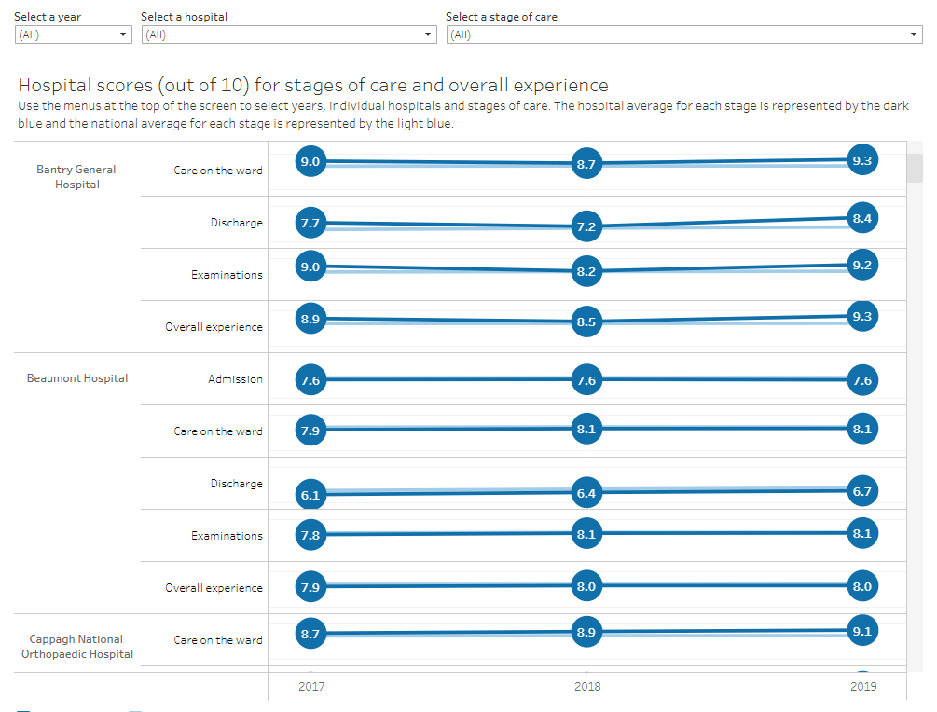
Local hospital results
Interactive results
Results for individual hospitals for each survey year are available at https://yourexperience.ie/inpatient/interactive-charts/

Slide 45
Experiences of a human rights-based approach to care in hospital
Report available from: https://yourexperience.ie/inpatient/human-rights-based-care/

Slide 46
National Inpatient Experience Survey 2022
(click video to play)
https://youtu.be/Lcrdy7T41f8

Slide 47
National Maternity Experience Survey

Slide 48
National Maternity Experience Survey
A national survey of women’s experiences of their maternity care
Providing women who have recently given birth in Ireland with the opportunity to share their experiences of maternity services
The aim is to learn from the experiences of these women to improve the safety and quality of maternity care in Ireland
First survey undertaken in 2020.

Slide 49
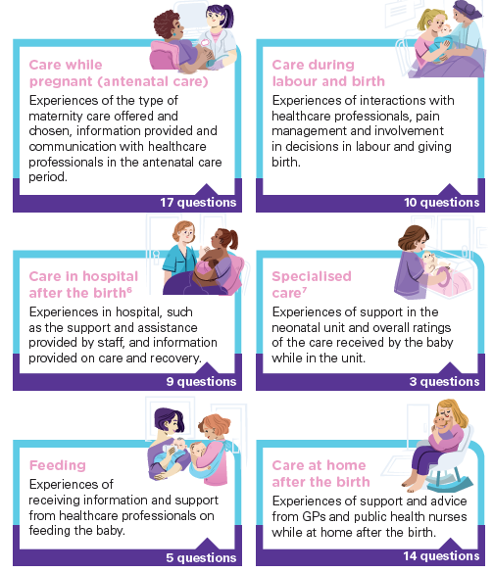
The questionnaire
68 questions
Online and postal response options
First invitation letter 4 months after birth
Two reminder letters at 2-week intervals
Polish, Lithuanian and Romanian versions also available.

Slide 50
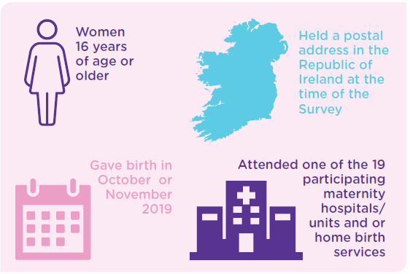
Who was invited to respond?
Women who met eligibility criteria:

Slide 51
Participants (2020)
Demographic profile of participants
Age category | No. | %
Under 25 | 155 | 4.8
25-29 | 451 | 14.1
30-34 | 1,173 | 36.6
35-39 | 1,146 | 35.8
40 or older | 280 | 8.7
Previous births
None | 1,240 | 42.2
One or two | 1,482 | 50.4
Three or more | 216 | 7.4
Ethnic group
White Irish | 2,602 | 82.5
Irish Traveller | 11 | 0.3
Roma | 10 | 0.3
Any other White background | 349 | 11.1
African | 41 | 1.3
Any other Black background | 3 | 0.1
Chinese | 12 | 0.4
Indian/Pakistani/Bangladeshi | 37 | 1.2
Any other Asian background | 18 | 0.6
Arabic | 14 | 0.4
Mixed | 30 | 1.0
Other | 28 | 0.9
6,357 women invited, with 3,204 responding (50%).
42.2% were first time mothers.
82.5% said they were from a ‘White Irish’ ethnic background.
Almost 2% gave birth to more than one baby.

Slide 52
National Maternity Experience Survey 2020
(click video to play)
https://youtu.be/C92v2lqAfUU

Slide 53
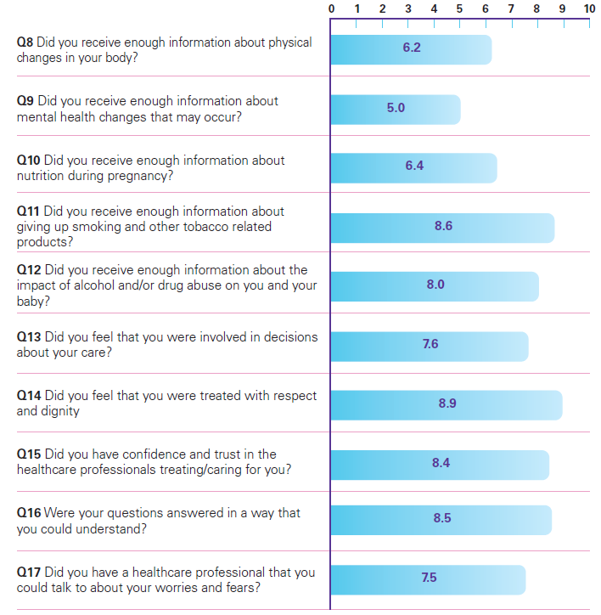
Care while pregnant
60% of women were offered a choice of maternity care.
Most chose public care.
Variation in availability of options nationwide.
990 women (32.3%) said that they did not receive enough information about changes in their mental health that may occur.
2,586 women (80.9%) said that they were always treated with respect and dignity while they were pregnant.

Slide 54
Comments from women on care while pregnant
“Antenatal classes were excellent. Very informative and enjoyable.”
“More hospital check-ups during pregnancy and scans needed. Felt I was barely looked at from 5 weeks to 34 weeks.”
“As a private patient I felt that information was not made available about pre- and post-natal classes that took place in the hospital.”
“The community midwife team and GP care during pregnancy was fantastic and made life a lot easier for me to attend appointments as they were local.”

Slide 55
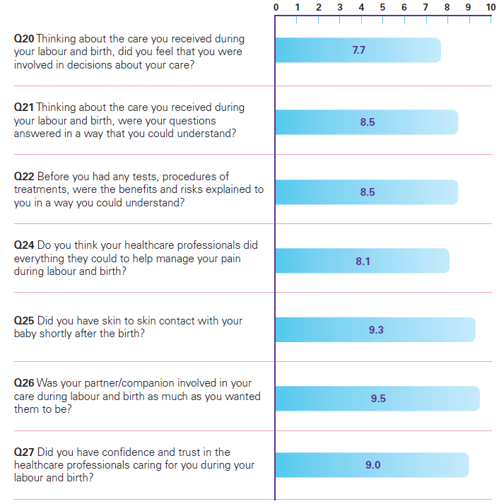
Care during labour and birth
39% of women said their labour was induced.
51% of women said they had an unassisted vaginal birth.
321 (10.1%) said they did not feel involved in decisions about their care during labour and birth.
2,969 women (95.2%) said that their partner or companion was as involved in their care as much as they wanted them to be.

Slide 56
Comments from women on care during labour and birth
“During labour felt very well looked after. I had a lot of confidence in the midwives and doctor.”
“Should be more discussion about pain relief options during labour. For first time mother should be extra care with their worries. At the hospital (during and after labour) should be more help to reduce stress.
“I had really good experience during my labour and birth time from the staff. They were really understanding and supportive when I was in labour pain. Really felt grateful to the staff who supported at this time and I think that is really important to every woman who are at that stage.”
“Early labour — felt very alone and unsupported. But in fairness, the nurses were very busy. I wasn’t really checked on.”

Slide 57
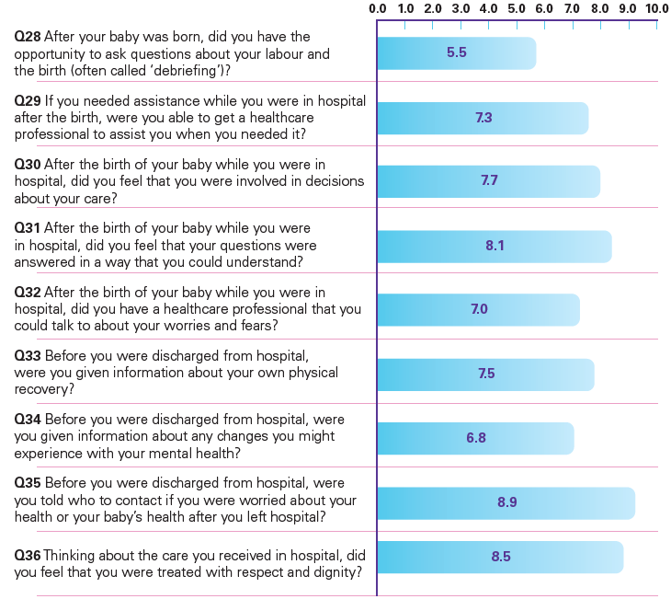
Care in hospital after birth
2,657 women (89.3%) said they were told who to contact if they were worried about their health or their baby’s health after they left hospital.
831 women (29.6%) who wanted to ask a question about their labour and birth said that they did not have the opportunity to do so.

Slide 58
Comments from women on care in hospital after birth
“Information/ support for the mother after birth, there is no follow up on the general health of the mother, what is ‘normal’ in recovery or not. Everything centres around the baby, it feels like you are unimportant once the baby is no longer in utero.”
“The aftercare
was fantastic! My
consultant was also
amazing!”
“The level of care from the majority of the nurses post giving birth was amazing and hugely improved on from my last experience with my first baby.”
“More support for first time mums, allowing husband/partner stay a little longer the first night, quite daunting being left alone.”

Slide 59
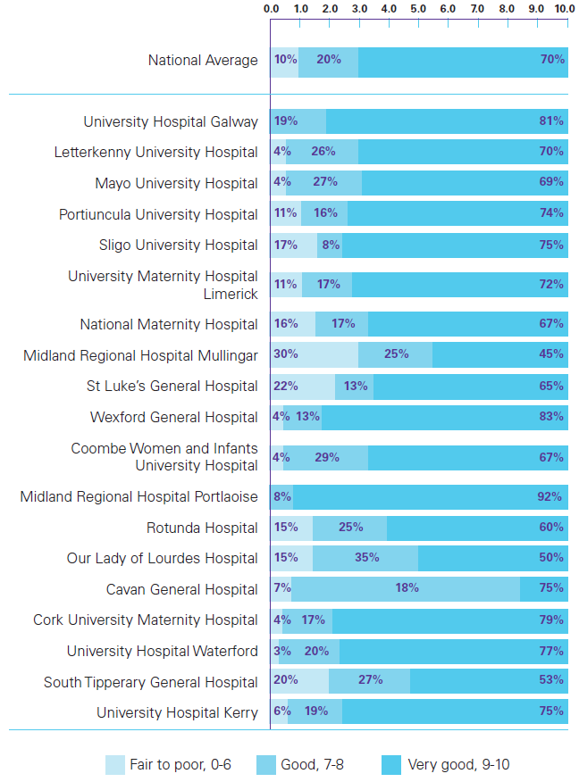
Specialised care
561 women (17.8%) said that their baby spent time in a neonatal unit.
Of these women, 262 (46.8%) said that they always received enough emotional support from healthcare professionals.
There were significant differences between hospitals for women’s overall rating of neonatal unit care.

Slide 60
Comments from women on specialised care
“The only issue for me was that I was terribly distraught emotionally when the baby was taken to ICU and I don’t think I was given the support for the emotions of that. I don’t think the staff noticed and it is quite likely that they are so busy taking care of the babies that this is not a concern for them.”
“The midwives and neo natal staff were professional and personable, they made me feel confident that my baby and I were receiving the best care.”
“The care my baby got in neonatal was excellent and the nurses made a very stressful few weeks into a positive experience! These nurses are angels!”
“There was no effort made in the neonatal unit to help breastfeeding mothers, in fact I felt it was discouraged despite the fact my baby was fit to be breastfed.”

Slide 61
Feeding
Most women said that feeding options were discussed with them. 8% said feeding options were not discussed.
42% said their baby was breastfed in the first few days.
2,391 women (74.9%) said that their decisions about feeding were always respected by healthcare professionals.
444 women (15.1%) said that they did not receive sufficient support from healthcare professionals to feed their baby while in hospital.

Slide 62
Comments from women on feeding
“I struggled with breast feeding initially and my public health nurse could not have been better. She linked in with me almost everyday for the first week and gave me so much information on support groups, etc.”
“More help with breast feeding badly, badly needed. Constantly rang bell for help where I was assisted for one minute and left again and baby would unlatch.”
“Mixed advice regarding feeding my baby 1. Breastfeeding. 2. Other nurse bottle and breast. All nurses had different advice, some very pushy on breastfeeding.”
“The lactation nurse was excellent in terms of support and encouragement.”

Slide 63
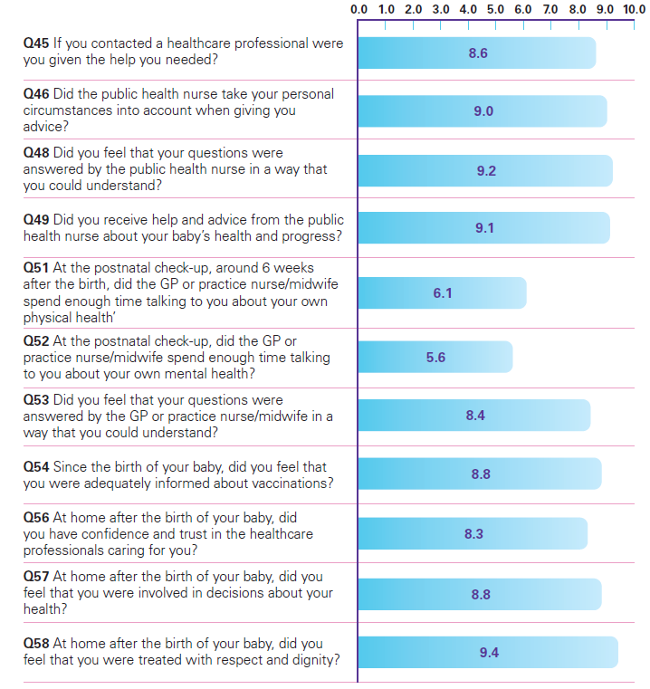
Care at home after birth
99% said they had been visited at home by a public health nurse.
85% said their baby received 2-week check-up with a GP.
88.5% said that they were always treated with respect and dignity at home after the birth.
28.7% said that their GP, practice nurse or midwife did not spend enough time discussing their mental health at their postnatal check-up.

Slide 64
Comments from women on care at home after birth
“My PHN after the birth of my baby was the best thing about my whole experience. She cared for both me and my baby extremely well for the weeks after.”
“Experience with the public health nurse was not enjoyable. I felt I was being put under a lot of pressure around how quickly my daughter should gain weight. Resulted in me having to go to the GP for a second opinion.”
“I had a very good experience. My GP is very supportive and understanding.
“The GP post natal check was rushed and left me worried about the vaccinations.”

Slide 65
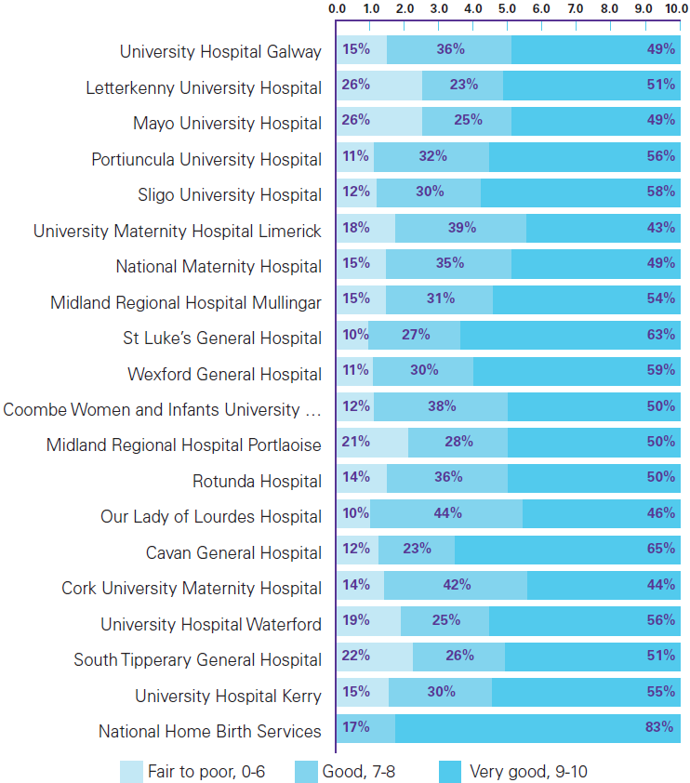
Overall experience
Women asked to rate their overall experience on a scale from 0 to 10.
85% rated their experience as ‘good’ or ‘very good’ (score of 7 or higher).
Variation by hospital/unit:
women who had a home birth most likely to give a positive rating.
note of caution: very small number of home birth responses (n=18).

Slide 66
Conclusion
Most women said they had a positive maternity care experience.
‘Care during labour and birth’ was the highest-rated stage of care. ‘Care while pregnant’ was the lowest-rated stage.
Areas of good experience included interactions with midwives, being treated with respect and dignity, and women’s confidence and trust in healthcare professionals.
Areas for improvement included availability of maternity care choices, mental health support and assistance with feeding.

Slide 67
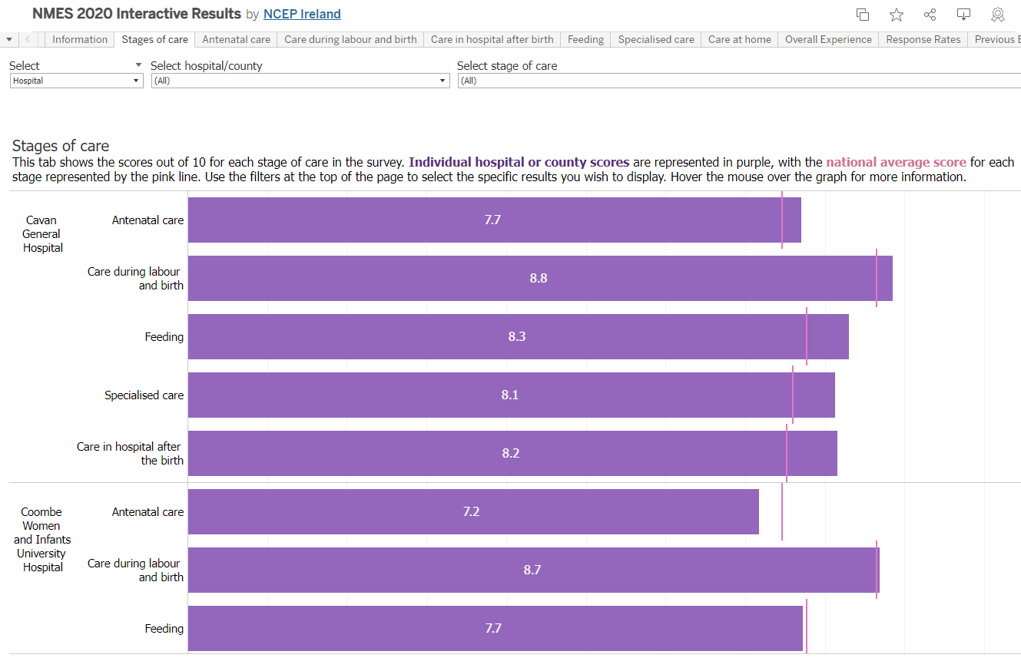
Local hospital and community results
Results at local hospital and county level are available at https://yourexperience.ie/maternity/interactive-charts/
Interactive results

Slide 68
National Nursing Home Experience Survey

Slide 69
National Nursing Home Experience Survey
Following the publication of the COVID-19 Expert Panel Final Report by the Expert Panel on Nursing Homes in July 2020, a recommendation was made to expedite the expansion of the National Care Experience Programme to nursing home residents.
The National Nursing Home Experience Survey captures the experiences of nursing home residents and their family members and friends.
The survey aims to highlight areas of good experience in nursing homes while also informing quality improvements, supporting the development of policy, national standards and monitoring programmes.

Slide 70
National Nursing Home Experience Survey
(click video to play)
https://youtu.be/mVSFZ7FwNLo

Slide 71
Survey overview
Survey population | Nursing home residents living in a representative sample of nursing homes in Ireland, and their family members or friends.
Survey period | 7 March 2022 to 17 June 2022.
Survey tools | 2 questionnaires were used: one for residents and one for family members/friends.
Survey administration | Face-to-face interviews with residents with a trained interviewer, and a postal survey for one nominated family member or friend of each resident.
Outputs | National report and thematic reports (no individual nursing home reports). Interactive survey results, secure access to online dashboard.

Slide 72
Survey themes and questions
The survey contains questions on:
Your experience here
Moving into the nursing home
Caregivers and staff
Spending time in the nursing home
Living environment
Person-centred care
Food and nutrition.
Results will be published in October 2022 and will be available at https://yourexperience.ie/nursing-homes/about-the-survey/.

Slide 73
National Maternity Bereavement Experience Survey

Slide 74
National Maternity Bereavement Experience Survey
This will be the first national survey of bereaved mothers’ and their partners’ experiences of Irish maternity bereavement care.
The aim of the survey is to capture meaningful information on bereaved mothers’ and their partners’ experiences of care in a sensitive and appropriate manner.
Listening to the lived experiences of parents will acknowledge what was good about their care and what can be done better.

Slide 75
Survey themes and questions
The survey will contain questions on:
Communication & information
Admission care
Labour & birth
Care after birth and meeting the baby
Neonatal care
Postnatal care
Bereavement care
Post-mortem examination
Discharge and follow-up care
Experiences of partners/support person
The first National Maternity Bereavement Experience survey is due to be conducted in late 2022, with results due to be published in 2023. More information on the survey is available at https://yourexperience.ie/maternity-bereavement/about-the-survey/.

Slide 76
National End of Life Survey

Slide 77
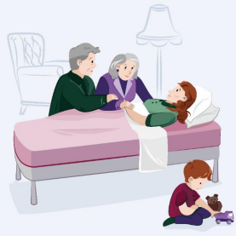
National End of Life Survey
The first National End of Life Survey will capture the experiences of care in the time leading up to a person’s death, from the perspective of bereaved relatives.
Survey results will be used to:
identify and replicate areas of good experience
identify areas in need of improvement
inform national policy and legislation
inform national standards and monitoring programmes.

Slide 78
Survey themes and questions
The survey will contain questions on:
care at home, in hospital, in a nursing home or hospice
coordination of care during the last three months of life
care in the last two days of life
experience of the bereaved relative.
The first National End of Life Survey is due to be conducted in early 2023.

Slide 79
Section 4. Impact

Slide 80
Impact
Measuring and reporting on the impact of projects promotes transparency, allows for the evaluation of a project against its stated objectives and demonstrates the effectiveness of a programme.
Outputs
Tangible entitites produced from projects
Reach
One-way communications about a project
Promotional material, information sessions
Engagement
Two-way communication about a project
Conferences, training programmes
Change
Changes in patient experience scores
Changes in practice/policy in response to the survey
Reports, policies, quality improvements
HIQA has developed a framework to support the measurement of impact through a combination of measures, including:

Slide 81
Impact

Slide 82
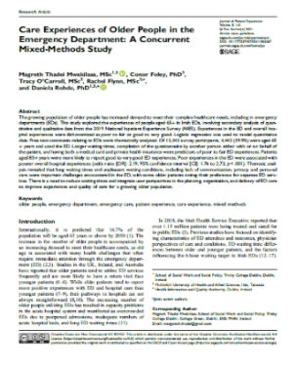
Outputs (2021)
Reports and papers
Survey development
Training and support documents
Three new surveys developed
Revised and implemented the National Inpatient Experience Survey
Data Protection Impact Assessments (DPIAs)
NCEP Strategy 2022-2024
Communications and Stakeholder Engagement Strategy 2022-2024 Information Management Strategy

Slide 83
Quality Improvement
Results from surveys inform the development of quality improvement plans
HSE National Healthcare Communication Programme
Improvements in patient discharge
Examples of quality improvement initiatives (pre-COVID-19)
Medication safety
Medication safety counselling service for patients on discharge from hospital (Beaumont Hospital).
Emergency department volunteers
Community volunteers to sit and wait with patients in the emergency department at weekends (St Luke’s Hospital Kilkenny).
Emergency department waiting times
13% reduction in emergency department waiting times as a result of the recruitment of two additional registrars in emergency medicine (St James’s Hospital).
Saolta HG
Mercy UH, Cork

Slide 84
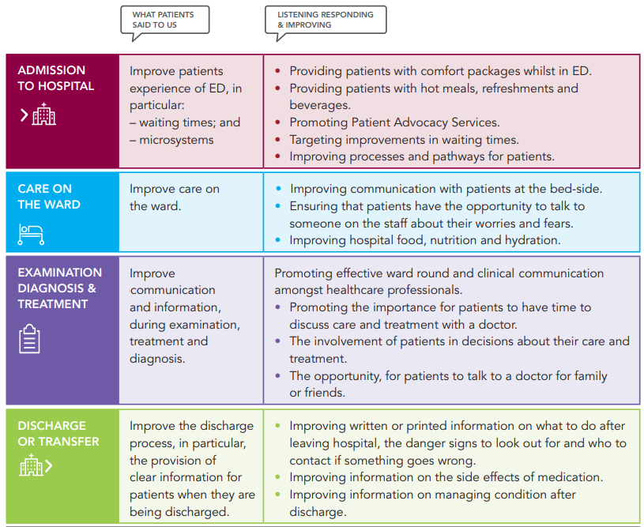
Communication and information
Patients, families and carers want to feel enabled and empowered, listened to and involved in decision-making about their care.
Better communication and clear information lead to better decisions, better experiences and outcomes for patients
The findings from the National Inpatient Experience Survey highlighted areas for improvement with respect to communication in healthcare during examination, treatment and diagnosis.
Listening, Responding and Improving: The HSE response to the findings of the National Inpatient Experience Survey 2019

Slide 85
Communication and information (2017-2019)
“The registrar and consultants team were very diligent and conscientious, examining and reviewing my symptoms, recording my results from blood tests and scans and feeding back information at their earliest convenience about my condition and treatment options.”
“The time that you spent with the doctors. It feels like they just come to see you because is on their checklist. They emphasize a sense of urgency and try to leave as soon as possible, not giving you the time to process their answers and formulate new questions.”
“I felt I left the hospital not really knowing much about my condition. I have since been back twice with the same condition and I'm still confused and have lost all faith at this stage….”
“Never knew what time doctor was going to visit i.e. ward round. Could not plan for a family member to be there as doctor could call at am or pm.”
“I felt I was not listened to. I was sent home with very little warning to live alone with new medication I did not understand.”

Slide 86
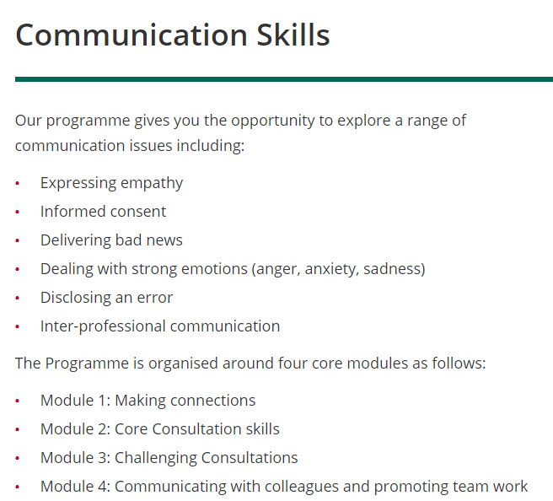
National Healthcare Communication Programme
The National Healthcare Communication Programme was established in response to findings from the National Inpatient Experience Survey.
Designed to support healthcare staff to learn, develop and maintain their communication skills with patients, their families and with colleagues.
Underpinned by core values of care, compassion, trust and learning, with a focus on person‐centred and clinical communication skills.
https://www.hse.ie/eng/about/our-health-service/healthcare-communication/

Slide 87
National Healthcare Communication Programme
To inform the ongoing development of the National Healthcare Communication Programme guidance for healthcare staff, including in maternity services, the NHCP undertook a review of questions and women’s comments in the National Maternity Experience Survey 2020.
The survey found that some women were not given the opportunity to ask questions and were not as involved as much as they wanted to be in decisions about their care after birth.
Many women felt they did not receive sufficient information and support for their mental health, not just in the period after birth, but also during their pregnancy.
Notes:
Based out of the response – each tick box is given
No – gets zero – yes fiently – 9 out 10 - divided

Slide 88
Medicines A-Z
Medicines A-Z (https://www2.hse.ie/conditions/medicines/)
One of the areas for improvement identified by the National Inpatient Experience Survey was information on medications.
From 2017 to 2019, 11.0% of patients (n=3,360) said that the purpose of medicines they were to take at home were not explained to them in a way that they could understand.
38.5% (n=10,291) reported that they were not told about the side effects of medications to watch out for when they went home.
The HSE’s Medicines A-Z resource was developed in response to these findings, in collaboration with general practitioners, the Royal College of Surgeons in Ireland, SaferMeds and the Health Products Regulatory Authority (HPRA).

Slide 89
Implementation of the National Maternity Strategy
The results of the National Maternity Experience Survey 2020 were used to inform the allocation of funding in 2021, including funding targeted at improving post-natal supports and new lactation consultant posts.
Significant additional funding has been provided to maternity services in 2021 and 2022 to facilitate the implementation of quality improvement plans developed in response to the survey.

Slide 90
Specialist Perinatal Mental Health Services Model of Care
Questions relating to mental health were some of the lowest-scoring questions in the National Maternity Experience Survey:
A third of women said that they did not receive enough information about changes in their mental health that may occur while they were pregnant.
29% said that their GP, practice nurse or midwife did not spend enough time discussing their mental health at their postnatal check-up.
These findings reinforced the importance of the implementation of the Specialist Perinatal Mental Health Services Model of Care.
This has led to an increase in diagnoses and heightened vigilance of mental health issues throughout the pregnancy, birth and postnatal periods.

Slide 91
Section 5. Useful resources

Slide 92
Useful resources
Website
Survey Hub
Podcast
Publications
Requesting data for research

Slide 93
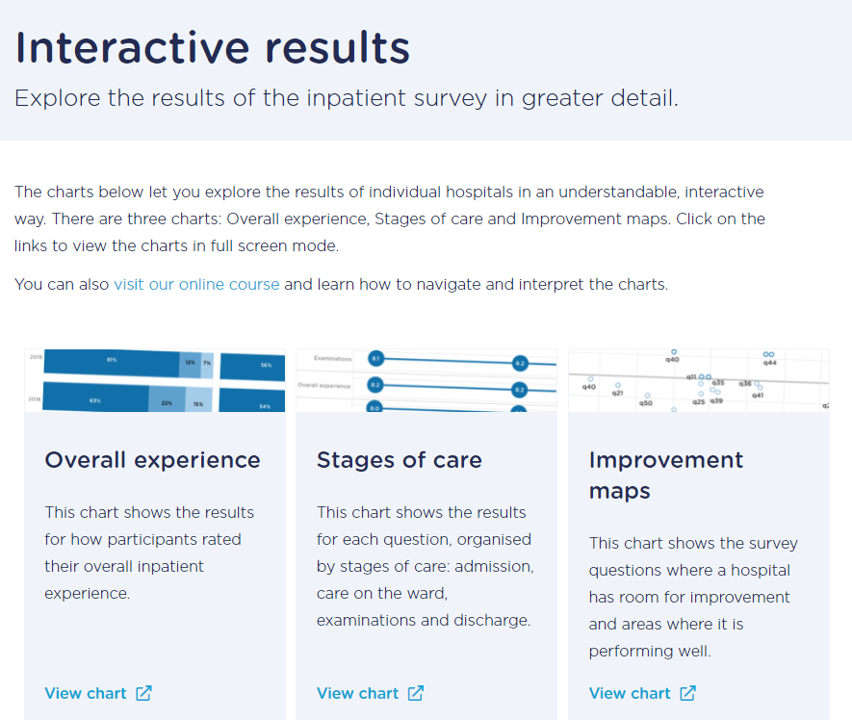
Website
More information about the National Care Experience Programme, as well as each of the programme’s surveys, is available on www.yourexperience.ie.
The website includes links to reports and publications, interactive survey results, and the survey hub.
https://yourexperience.ie/inpatient/interactive-charts/

Slide 94
Survey Hub

Slide 95
Survey Hub
The Survey Hub provides a lot of useful material to use when developing surveys and understanding survey results.
It also contains information on various research projects that utilise data from the National Care Experience Programme, including publications, conference posters and presentations.
There are six e-learning modules available:
Introduction to survey design
Questionnaire design
Survey administration
Survey data
Analysing and presenting survey findings
National Care Experience Programme interactive dashboards
https://yourexperience.ie/survey-hub/

Slide 96
Let’s Talk Care Experience podcast
This podcast discusses all aspects of people’s experiences of Ireland’s health and social care services. The podcast features people who use services, staff within services, as well as leading health and social care experts.
Let's Talk Care Experience | Apple Podcasts
Let's Talk Care Experience | Podcast on Spotify
Let's Talk Care Experience | Podcast Addict

Slide 97
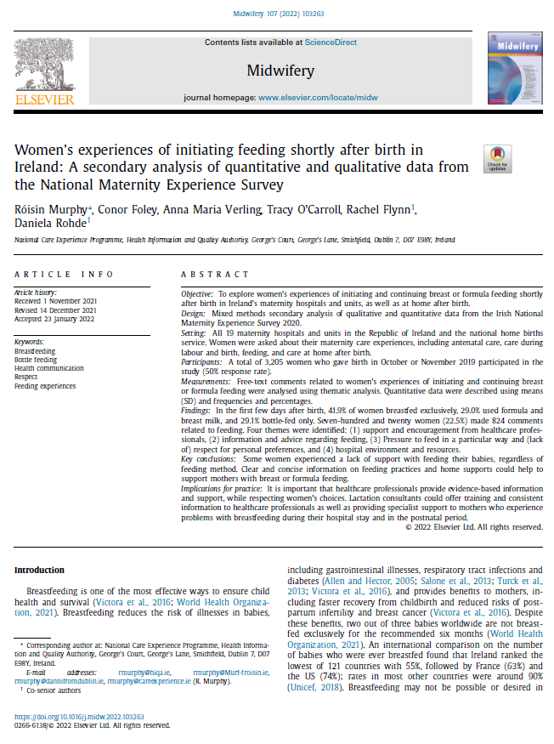
Publications
In addition to reports of survey findings, the National Care Experience Programme has published a number of peer-reviewed papers.
Examples include:
Older people’s experiences in the emergency department
Women’s experiences of infant feeding shortly after birth.

Slide 98
Requesting data for research
NCEP survey data can be requested for research purposes:
Read the Data Access Request Policy 2020
Download and complete the Data Access Request Form
Submit the request
By email: info@yourexperience.ie
By post: National Care Experience Programme
Health Information and Quality Authority
Unit 1301, City Gate
Mahon, Cork. T12 Y2XT.
https://yourexperience.ie/about/contact-us/request-data-for-research/

Slide 99
THANK YOU
QUESTIONS
Follow us on:
@CareExperience
/YourInpatientExperience
/CareExperience
@CareExperience
www.yourexperience.ie
If you found this slide deck useful, or have any comments or suggestions, we would love to hear from you! Please contact us at info@yourexperience.ie.

